Slide 1
A Study of Air Pollution From the Chernobyl Disaster
By Adam Alder, Ben Ashton, and Spencer Lingwall

Slide 2
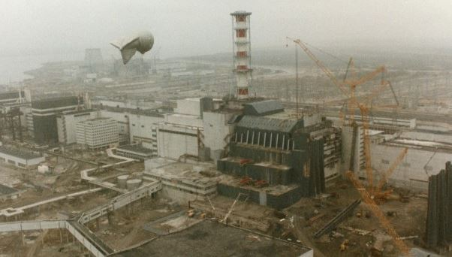
Overview
The Chernobyl Disaster left a mark of fear on the world from the terrifying effects of the nuclear fallout it caused. Not only was the immediate area destroyed, but areas hundreds of miles away were also affected. By studying the air pollution that came as a result of the disaster we can better inform people of the risks of nuclear power and how large mistakes can affect surrounding areas.

Slide 3
Data Description
The data used is from the Chernobyl Disaster Air Concentration dataset from OpenML. This dataset presents concentrations of Iodine-131 (I-131) and Caesium-134 (Cs-134) and Caesium-137 (Cs-137) as aerosol particles which were measured in specific location and date. Location is represented by country, locality, as well as latitude/longitude pairs. In the dataset, time is represented by the date (year/month/day), the time of day that sampling was concluded, and the duration of the sampling.
Our Data primarily comes from countries in Europe to the west of Ukraine.
The dataset can be found at: https://www.kaggle.com/datasets/debjeetdas/air-concentration-fheaor-the-chernobyl-disaster

Slide 4
Goals
Our primary questions we want answered are:
Which isotopes have the greatest concentration?
How far did the particles travel from the nuclear site?
Is there a wind drift that affected the area? What might the atmospheric currents look like?
What is a safe distance from a disaster site such as Chernobyl?

Slide 5
Tools And Libraries Used
Basemap: https://matplotlib.org/basemap/
Pyvista: https://docs.pyvista.org/version/stable/index.html
OpenVisus: https://sci-visus.github.io/OpenVisus/
Numpy: https://numpy.org/doc/
Pandas: https://pandas.pydata.org/docs/
Matplotlib: https://matplotlib.org/stable/index.html
Animated GIF Maker: https://ezgif.com/maker

Slide 6
Description of Solution: Which Isotopes have the Greatest Concentration?
From our visualizations we could see that Iodine-131 (I-131) was the isotope with the highest concentration. It had concentrations of close to 70 Bq/m3 which was much higher than either Cesium Isotope.

Slide 7
Description of Solution: How far did the particles travel from the nuclear site?
The biggest concentration of the isotopes was found in Austria. There was also an early spike in Sweden within the first few days. This means the isotopes travelled quickly across Europe and within a few days had covered most of the area. Areas Like Austria and Switzerland which were mountainous caught the isotopes and appeared to trap them. This means the isotopes easily traveled 1000 miles over the course of 2 days. Over mountainous terrain they took around 4 days to go the same distance.

Slide 8
Description of Solution: How far did the particles travel from the nuclear site?

Slide 9
Description of Solution: Is there a wind drift that affected the area? What might the atmospheric currents look like?
Atmospheric currents were rather hard to deduce from the data as we only had radiation data. We were to deduce isotope approximate travel paths that would have had to occur to have the concentrations that we were seeing.

Slide 10
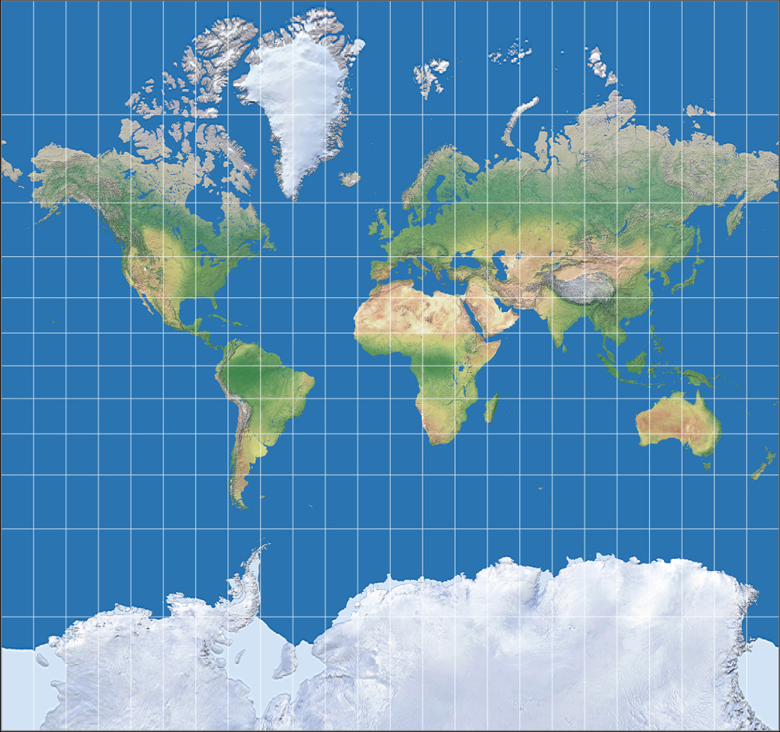
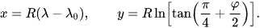
Challenges
Mercator Projection Problem:
VTK - Hard to do….
Pywidgets… Slow

Slide 11
Changes we made
No longer using VTK
Added a 3D Visualization
Turing Charts into Map visualizations
Using GIFs to display the flow of time

Slide 12
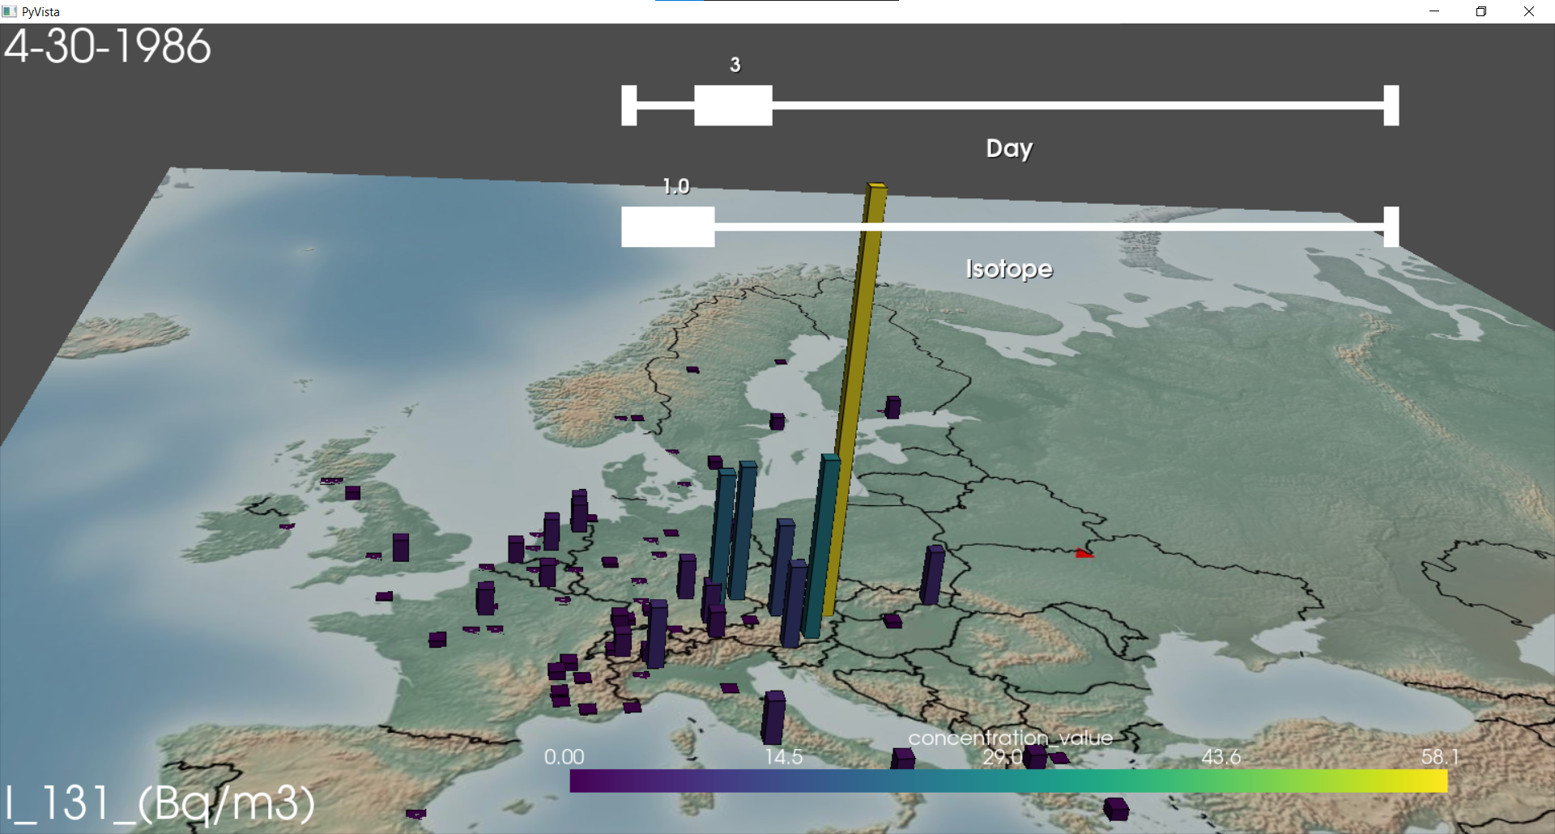
3D Visualization - Demonstration

Slide 13
QUESTIONS???

